Slide 1

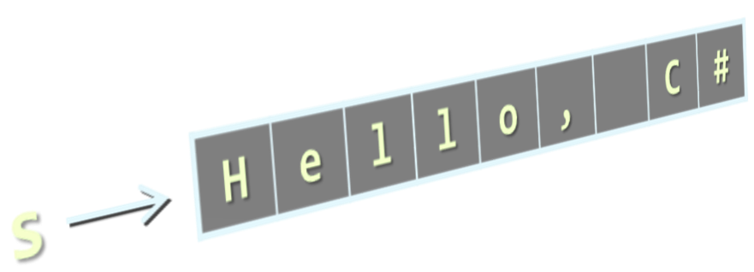
Strings
Strings are sequences of characters (texts)
The string data type in C#
Declared by the string keyword
Maps to System.String .NET data type
Strings are enclosed in quotes:
Concatenated using the "+" operator:
string s = "Hello, C#";
string
string s = "Hello" + " " + "C#";

Slide 2
In C# Strings are Immutable, use Unicode
Strings are immutable (read-only) sequences of characters
Accessible by index (read-only)
Strings use Unicode (can use most alphabets, e.g. Arabic)
string str =
"Hello, C#";
let ch = str[2]; // OK
str[2] = 'a'; // Error!
index =
0 | 1 | 2 | 3 | 4 | 5 | 6 | 7 | 8
H | e | l | l | o | , |  | C | #
str[index] =
string greeting = "السَّلَامُ عَلَيْكُمْ"; // As-salamu alaykum

Slide 3
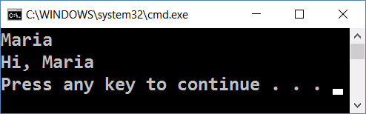
Initializing a String
Initializing from a string literal:
Reading a string from the console:
Converting a string from and to a char array:
0 | 1 | 2 | 3 | 4 | 5 | 6 | 7 | 8
H | e | l | l | o | , |  | C | #
string str = "Hello, C#";
string name = Console.ReadLine();
Console.WriteLine("Hi, " + name);
string str = new String(new char[] {'s', 't', 'r'});
char[] charArr = str.ToCharArray(); // ['s', 't', 'r']

Slide 4


Manipulating Strings
string
Comparing, Concatenating, Searching, Extracting Substrings, Splitting

Slide 5

Comparing Strings
Ordinal (exact binary) string comparison
Case-insensitive string comparison
Case-sensitive string comparison
int eq = (str1 == str2); // uses String.Equals(…)
int result = string.Compare(str1, str2, true);
// result == 0 if str1 equals str2
// result < 0 if str1 is before str2
// result > 0 if str1 is after str2
int result = string.Compare(str1, str2, false);

Slide 6

Concatenating (Combining) Strings
Use the Concat() method
Use the + or the += operators
Any object can be appended to a string
string str = string.Concat(str1, str2);
string str = str1 + str2 + str3;
string str += str1;
string name = "Peter"; int age = 22;
string s = name + " " + age; // → "Peter 22"

Slide 7

Searching in Strings
Finding a substring within a given string
str.IndexOf(string term) – returns the first index or -1
str.LastIndexOf(string term) – finds the last occurence
string email = "vasko@gmail.org";
int firstIndex = email.IndexOf("@"); // 5
int secondIndex = email.IndexOf("a", 2); // 8
int notFound = email.IndexOf("/"); // -1
string verse = "To be or not to be…";
int lastIndex = verse.LastIndexOf("be"); // 16

Slide 8
Problem: Count Substring Occurrences
You are given a text and a pattern
Find how many times that pattern occurs in the text
Overlapping is allowed
ababa caba
aba
3
aaaaaa
aa
5
Welcome to SoftUni
Java
0
Check your solution here: https://judge.softuni.bg/Contests/Practice/Index/320#1

Slide 9
Solution: Count Substring Occurrences
string input = Console.ReadLine().ToLower();
string pattern = Console.ReadLine().ToLower();
int counter = 0;
int index = input.IndexOf(pattern);
while (index != -1)
{
counter++;
index = input.IndexOf(pattern, index + 1)
}
Console.WriteLine(counter);

Slide 10

Extracting Substrings
str.Substring(int startIndex, int length)
str.Substring(int startIndex)
string filename = @"C:\Pics\Rila2017.jpg";
string name = filename.Substring(8, 8);
// name == "Rila2017"
string filename = @"C:\Pics\Rila2017.jpg";
string nameAndExtension = filename.Substring(8);
// nameAndExtension == "Rila2017.jpg"
0 | 1 | 2 | 3 | 4 | 5 | 6 | 7 | 8 | 9 | 10 | 11 | 12 | 13 | 14 | 15 | 16 | 17 | 18 | 19
C | : | \ | P | i | c | s | \ | R | i | l | a | 2 | 0 | 1 | 7 | . | j | p | g

Slide 11

Splitting Strings
Split a string by given separator(s) :
Example:
string[] Split(params char[] separator)
string listOfBeers = "Amstel, Zagorka, Tuborg, Becks.";
string[] beers = listOfBeers.Split(' ', ',', '.');
Console.WriteLine("Available beers are:");
foreach (string beer in beers)
Console.WriteLine(beer);

Slide 12

Other String Operations
Replacing and Deleting Substrings, Changing Character Casing, Trimming

Slide 13


Replacing and Deleting Substrings
str.Replace(match, replacement) – replaces all occurrences
The result is a new string (strings are immutable)
str.Remove(int index, int length) – deletes part of a string
Produces a new string as result
string cocktail = "Vodka + Martini + Cherry";
string replaced = cocktail.Replace("+", "and");
// Vodka and Martini and Cherry
string price = "$ 1234567";
string lowPrice = price.Remove(2, 3);
// $ 4567

Slide 14
Problem: Text Filter (Banned Words)
You are given a text and a string of banned words
Replace all banned words in the text with asterisks
Replace with asterisks (*), whose count is equal to the word's length
Linux, Windows
It is not Linux, it is GNU/Linux. Linux is merely the kernel, while GNU adds the functionality...
It is not *****, it is GNU/*****. ***** is merely the kernel, while GNU adds the functionality...
Check your solution here: https://judge.softuni.bg/Contests/Practice/Index/320#2

Slide 15
Solution: Text Filter
string[] banWords = Console.ReadLine()
.Split(…); // TODO: add separators
string text = Console.ReadLine();
foreach (var banWord in banWords)
{
if (text.Contains(banWord))
{
text = text.Replace(banWord,
new string('*', banWord.Length));
}
}
Console.WriteLine(text);
Contains(…) checks if string contains another string
Replace a word with a sequence of asterisks of the same length

Slide 16

Changing Character Casing
Using the method ToLower()
Using the method ToUpper()
string alpha = "aBcDeFg";
string lowerAlpha = alpha.ToLower(); // abcdefg
Console.WriteLine(lowerAlpha);
string alpha = "aBcDeFg";
string upperAlpha = alpha.ToUpper(); // ABCDEFG
Console.WriteLine(upperAlpha);

Slide 17

Trimming White Space
str.Trim() – trims whitespaces at start and end of string
str.Trim(params char[] chars)
str.TrimStart() and str.TrimEnd()
string s = " example of white space ";
string clean = s.Trim();
Console.WriteLine(clean); // example of white space
string s = " \t\nHello!!! \n";
string clean = s.Trim(' ', ',' ,'!', '\n','\t');
Console.WriteLine(clean); // Hello
string s = " C# ";
string clean = s.TrimStart(); // clean = "C# "

Slide 18

String Operations
Live Exercises in Class (Lab)

Slide 19

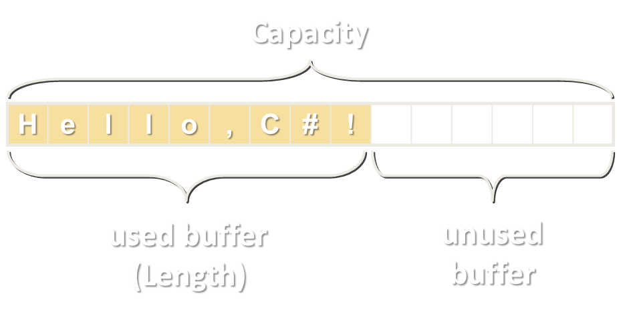
Building and Modifying Strings
Using the StringBuilder Class

Slide 20
StringBuilder: How It Works?
Capacity
StringBuilder:
Length = 9
Capacity = 15
H | e | l | l | o | , | C | # | !
used buffer
(Length)
unused buffer
StringBuilder keeps a buffer space, allocated in advance
Do not allocate memory for most operations → performance

Slide 21
Changing the Contents of a String
Use the System.Text.StringBuilder to build / modify strings:
public static string ReverseString(string str)
{
StringBuilder sb = new StringBuilder();
for (int i = str.Length - 1; i >= 0; i--)
{
sb.Append(str[i]);
}
return sb.ToString();
}
Notes:
Introducing the StringBuffer Class
StringBuffer represents strings that can be modified and extended at run time. The following example creates three new String objects, and copies all the characters each time a new String is created:
String quote = "Fasten your seatbelts, ";
quote = quote + "it's going to be a bumpy night.";
It is more efficient to preallocate the amount of space required using the StringBuffer constructor, and its append() method as follows:
StringBuffer quote = new StringBuffer(60); // allocate 60 chars
quote.append("Fasten your seatbelts, "); quote.append(" it's going to be a bumpy night. ");
StringBuffer also provides a number of overloaded insert() methods for inserting various types of data at a particular location in the string buffer.
Instructor Note
The example in the slide uses StringBuffer to reverse the characters in a string. A StringBuffer object is created, with the same length as the string. The loop traverses the String parameter in reverse order and appends each of its characters to the StringBuffer object by using append(). The StringBuffer therefore holds a reverse copy of the String parameter. At the end of the method, a new String object is created from the StringBuffer object, and this String is returned from the method.

Slide 22
The StringBuilder Class
StringBuilder(int capacity) constructor allocates in advance buffer of size capacity
Capacity holds the currently allocated space (in characters)
Length holds the length of the string in the buffer
this[int index] (indexer) access the char at given position
Capacity
H | e | l | l | o | , | C | # | !
used buffer (Length)
unused buffer

Slide 23
StringBuilder Operations – Examples
var builder = new StringBuilder(100);
builder.Append("Hello Maria, how are you?");
Console.WriteLine(builder); // Hello Maria, how are you?
builder[6] = 'D';
Console.WriteLine(builder); // Hello Daria, how are you?
builder.Remove(5, 6);
Console.WriteLine(builder); // Hello, how are you?
builder.Insert(5, " Peter");
Console.WriteLine(builder); // Hello Peter, how are you?
builder.Replace("Peter", "George");
Console.WriteLine(builder); // Hello George, how are you?

Slide 24
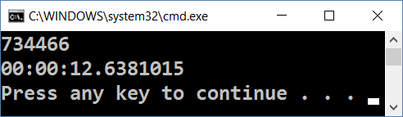
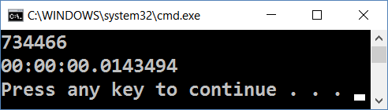
Problem: String Concatenation
Given the code below try to optimize it to go under a second
Do not change the loop or the Convert.ToString() method
var timer = new Stopwatch();
timer.Start();
string result = "";
for (int i = 0; i < 50000; i++)
result += Convert.ToString(i, 2);
Console.WriteLine(result.Length);
Console.WriteLine(timer.Elapsed);

Slide 25
Solution: String Concatenation
var timer = new Stopwatch();
timer.Start();
var result = new StringBuilder();
for (int i = 0; i < 50000; i++)
result.Append(Convert.ToString(i, 2));
Console.WriteLine(result.Length);
Console.WriteLine(timer.Elapsed);

Slide 26

Summary
Strings are immutable sequences of Unicode characters
String processing methods
IndexOf(), Compare(), Substring(), Remove(), ToUpper / ToLower(), Replace(), …
StringBuilder efficiently builds / modifies strings
string str = "Hello, C#";
str[2] = 'a'; // Error!
var result = new StringBuilder();
for (int i = 0; i < 500000; i++) result.Append(i.ToString());

